Slide 1
Achieving Unified Memory
for FPGA-Based String Matching
Zhuoxuan Sun, Jincheng Zhong, Jiayao Wang, Shuhui Chen
National University of Defense Technology
Notes:
Good afternoon everyone. My name is [presenter name], from the National University of Defense Technology.
Today I'll present our work on achieving unified memory for FPGA-based string matching. This work addresses a fundamental memory fragmentation problem in hardware-accelerated network intrusion detection systems.

Slide 2
The Challenge
Network IDS must match patterns at line rate with limited FPGA memory
Network
Packets
Pre-filter
(FPGA)
Suspicious
Subset
Deep Check
(CPU)
→
→
→
Why pre-filter?
Most traffic should pass quickly
Only suspicious traffic gets expensive checks
Goal: line-rate filtering with small FPGA memory
Unified Memory for FPGA-Based String Matching
2
Notes:
Let me start with the big picture. Modern network intrusion detection systems need to match tens of thousands of patterns against every packet at line rate — that's 100 Gbps and beyond. The common approach is a two-stage pipeline: an FPGA-based pre-filter quickly identifies suspicious traffic, and only that small subset is passed to the CPU for deep inspection. This architecture is efficient because most traffic is benign — the pre-filter handles the bulk at line-rate, while expensive deep checks are limited to a tiny fraction. The key challenge is: how do we build this pre-filter to be both fast enough and memory-efficient on FPGA?

Slide 3
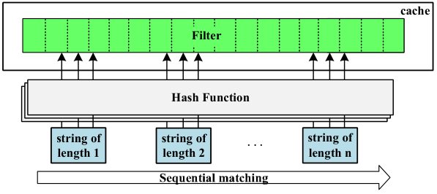
Software Approach
Flexible memory, but sequential matching limits throughput
✓ One shared memory pool
✗ Sequential → cannot reach 100 Gbps
Flexible memory usage, but not enough parallel throughput for high-rate traffic.
Unified Memory for FPGA-Based String Matching
3
Notes:
One natural approach is software-based matching. Software gives you flexible memory usage — all patterns share one memory pool, so there's no waste. However, software matching is inherently sequential. Even with optimizations, a single CPU core cannot sustain 100 Gbps throughput. You'd need many cores, and latency becomes unpredictable. So software alone doesn't meet our performance target.

Slide 4
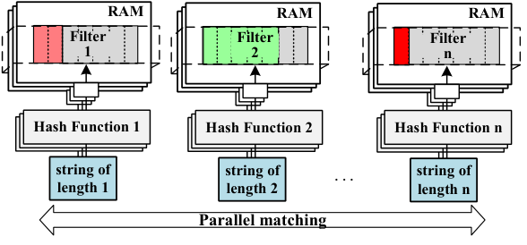
Traditional Hardware Approach
Parallel matching is fast, but each pattern length gets its own memory
✓ Parallel → 100 Gbps achievable
✗ Memory fragmentation (waste)
Each length-specific filter is sized for worst case — some full, others nearly empty.
Unified Memory for FPGA-Based String Matching
4
Notes:
The traditional hardware approach solves the throughput problem through parallelism. By dedicating separate hardware matching units to different pattern lengths, we can process many lengths simultaneously and achieve 100 Gbps. But this introduces a critical problem: memory fragmentation. Each pattern length gets its own dedicated memory bank, sized for the worst case. In practice, some banks are full while others are nearly empty. This wastes precious FPGA BRAM resources and limits the total number of patterns we can support.

Slide 5
Our Idea: Unified Memory Architecture
Before: Distributed Filters
Data Pipeline (3 stages)
Len=3 → RAM₁ (30% util)
① Matching Units
Len=5 → RAM₂ (60% util)
One unit per pattern length, parallel processing
Len=8 → RAM₃ (15% util)
② Crossbar Switch
Non-blocking routing, eliminates conflicts
After: Unified Memory
③ Shared RAM Read
All Lengths → Crossbar → Shared RAM
(90%+ utilization, zero fragmentation)
All pattern lengths access a unified BRAM pool
Key Insight: All pattern lengths share one filter → memory fully utilized with arbitrary length distributions, 100 Gbps line-rate
Notes:
This is the core insight of our work. Instead of assigning each pattern length its own separate filter — where utilization can be as low as 15% to 30% — we propose a unified memory architecture where all pattern lengths share a single pool of RAM banks.
The architecture has three pipeline stages. First, matching units — one per pattern length — process incoming data in parallel. Second, a crossbar switch provides non-blocking routing from matching units to shared banks, eliminating access conflicts. Third, all pattern lengths read from the same unified BRAM pool, achieving over 90% memory utilization with zero fragmentation.
The key advantage is that our system can store patterns across arbitrary length distributions within a specified length range, until reaching its maximum capacity. There's no longer a per-length capacity limit — the full memory is available to any length that needs it.

Slide 6
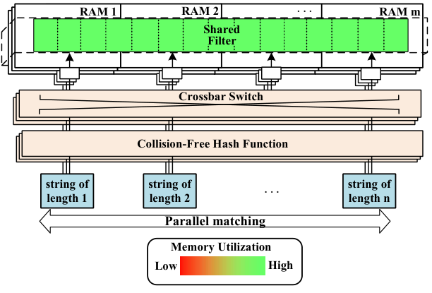
Our Idea: Unified Memory Architecture
Core Idea:
• All pattern lengths share one unified
filter (instead of separate filters)
• Eliminates memory fragmentation
Challenge:
• Need collision-free hash scheme
to avoid bank access conflicts
Unified Memory for FPGA-Based String Matching
8
Notes:
Let me elaborate on the architecture. The core idea is straightforward: replace N separate filters with one unified filter that all pattern lengths share. This eliminates memory fragmentation entirely.
But sharing memory introduces a new challenge: when multiple pattern lengths access the same bank pool, we need a hash scheme that guarantees each length maps to distinct banks. Otherwise, two lengths requesting the same bank in the same cycle creates a conflict. This is where our collision-free hash schemes come in.

Slide 7
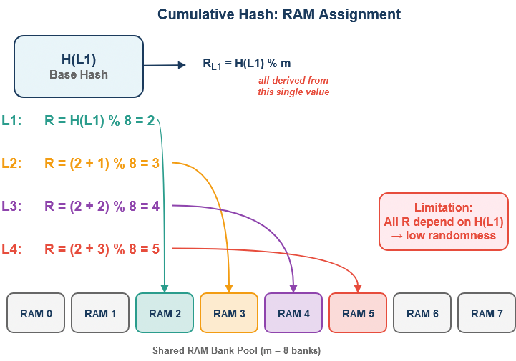
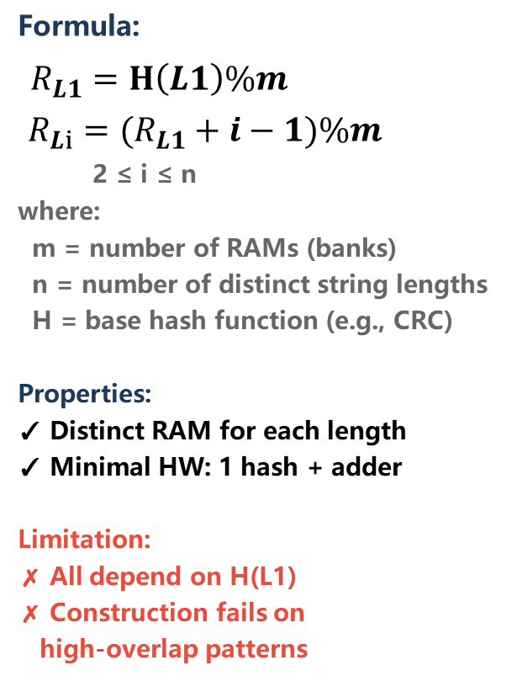
Cumulative Hash
Formula:
$R_{L1}=H\left(L1\right)\%m$
$R_{Li}=(R_{L1}+i−1)\%m$
2 ≤ i ≤ n
where:
m = number of RAMs (banks)
n = number of distinct string lengths
H = base hash function (e.g., CRC)
Properties:
✓ Distinct RAM for each length
✓ Minimal HW: 1 hash + adder
Limitation:
✗ All depend on H(L1)
✗ Construction fails on
high-overlap patterns
Notes:
Our baseline scheme is called Cumulative Hash. The idea is simple: compute one base hash H(L1) for the first pattern length, then derive all other bank assignments by adding sequential offsets. This guarantees that every pattern length maps to a distinct bank with minimal hardware.
However, Cumulative Hash has a fundamental limitation: all bank assignments depend on a single hash value. This means the randomness is severely constrained. When patterns have high overlap across lengths — what we call worst-case pattern sets — the xor filter construction can fail because there isn't enough randomness to resolve conflicts during the filter-building phase.

Slide 8
Collision-Free Hash Schemes
To overcome Cumulative Hash limitations, we propose two advanced schemes:
Binary Tree Hash
• Permutes incremental offsets via binary tree structure
• Breaks sequential dependency of Cumulative Hash
• Better randomness → supports more patterns
(58K/80K for worst-case L8-maxoverlap)
Cross Hash
• Dual-path design: Random Path + Tree Fallback
• Random Path: independent hashes for maximum dispersion
• Tree Fallback: guarantees collision-free construction
• Best randomness
(72K/80K for worst-case, 80K/80K for normal patterns)
→ Cross Hash achieves both high capacity and collision-free access for all pattern sets
Notes:
To overcome this limitation, we propose two advanced schemes.
Binary Tree Hash permutes the incremental offsets through a binary tree structure. Instead of simple sequential offsets, the LSB of each length's hash determines left or right branching in the tree. This breaks the sequential dependency of Cumulative Hash and provides better randomness. With Binary Tree Hash, we can support 58K out of 80K patterns even for the worst-case L8-maxoverlap set.
Cross Hash is our strongest scheme. It combines a random hash for maximum dispersion with a binary-tree fallback that guarantees collision-free construction. This combines the compactness of randomized storage with a hard collision-free guarantee. Cross Hash supports 72K out of 80K patterns for worst-case sets, and achieves full 80K capacity for all normal pattern sets like Snort and Suricata rules.

Slide 9
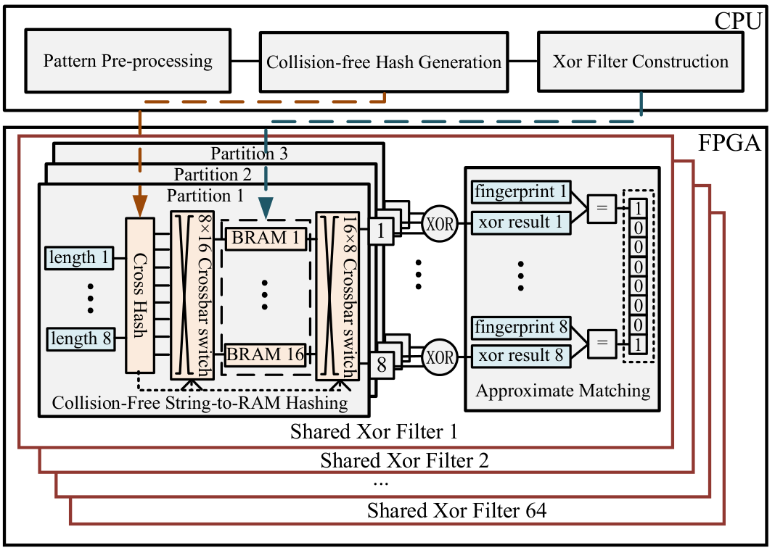
Implementation Overview
Resource Overhead
(64 filters)
LUTs: 518,982 (30.0%)
FFs: 290,942 (8.4%)
Block RAM: 3.38 MB (28.6%)
Notes:
We implemented the complete system on a Xilinx XCU250 FPGA. The system consumes 519K LUTs — that's 30% of the FPGA's total logic — along with 291K flip-flops at 8.4%, and 3.38 MB of Block RAM at 28.6%. These numbers cover the 64 parallel matching units of our system and confirm that the matching module is the dominant resource consumer, as expected for a memory-intensive matching task. The pipeline processes data at 100 Gbps line rate, with the crossbar switch implemented as a non-blocking interconnect that routes 24 queries per cycle — 8 pattern lengths times 3 hash functions each — to the shared bank pool without conflicts.

Slide 10
Hash Scheme Effectiveness
Table: Performance of filter construction across collision-free hash schemes
L8-maxoverlap
a b c d e f g h | **
fixed 8B | var 2B → 65K variants
⚠ stress test — not from real rules
Cap.
Pattern Set
Cumulative Hash
Binary Tree Hash
Cross Hash
#Pat
#Att
Time(s)
#Pat
#Att
Time(s)
#Pat
#Att
Time(s)
Snort
80K
1
2.2
80K
1
7
80K
1
7
80K
Suricata
80K
1
2.2
80K
1
7
80K
1
7
L8-random
80K
1
2.3
80K
1
8.2
80K
1
8.4
L8-maxoverlp
18K
1
0.5
58K
13
67.6
72K
63
352.8
Snort
40K
1
1.5
40K
1
4.5
40K
1
4.5
40K
Suricata
40K
1
1.5
40K
1
4.5
40K
1
4.5
L8-random
40K
1
2.3
40K
1
5.6
40K
1
5.5
L8-maxoverlp
10K
1
0.3
16K
2
3.4
16K
2
3.6
Cross Hash: supports 72K/80K patterns even for worst-case (L8-maxoverlap), all normal pattern sets → 80K with 1 attempt
Notes:
This table shows the filter construction performance across our three hash schemes. Before we look at the numbers, let me briefly explain the L8-maxoverlap dataset — since it is artificially constructed rather than extracted from any real ruleset. Every pattern is 10 bytes long, with the first 8 bytes completely identical across all patterns, and only the last 2 bytes varying. That gives up to 65,536 variants of a single prefix — for example, tens of thousands of variants of "abcdefgh" followed by two arbitrary bytes. In practice, one regular expression would replace all of them. The reason this is adversarial is that all these patterns share nearly identical hash values, so our hash schemes have very constrained choices for RAM assignment.
Now let me highlight the key results.
For normal pattern sets — Snort and Suricata rules, as well as random patterns — all three schemes achieve full capacity with just one construction attempt. The differences only appear for these adversarial worst-case patterns.
For the L8-maxoverlap set at 80K capacity: Cumulative Hash can only insert 18K patterns — it fails badly. Binary Tree Hash reaches 58K patterns but requires 13 attempts. Cross Hash achieves 72K patterns, the best among all schemes, though it needs 63 attempts for this extreme case.
The important takeaway: for real-world rule sets, Cross Hash fills to maximum capacity in a single attempt. The multiple-attempt scenario only arises for artificially adversarial pattern distributions.

Slide 11
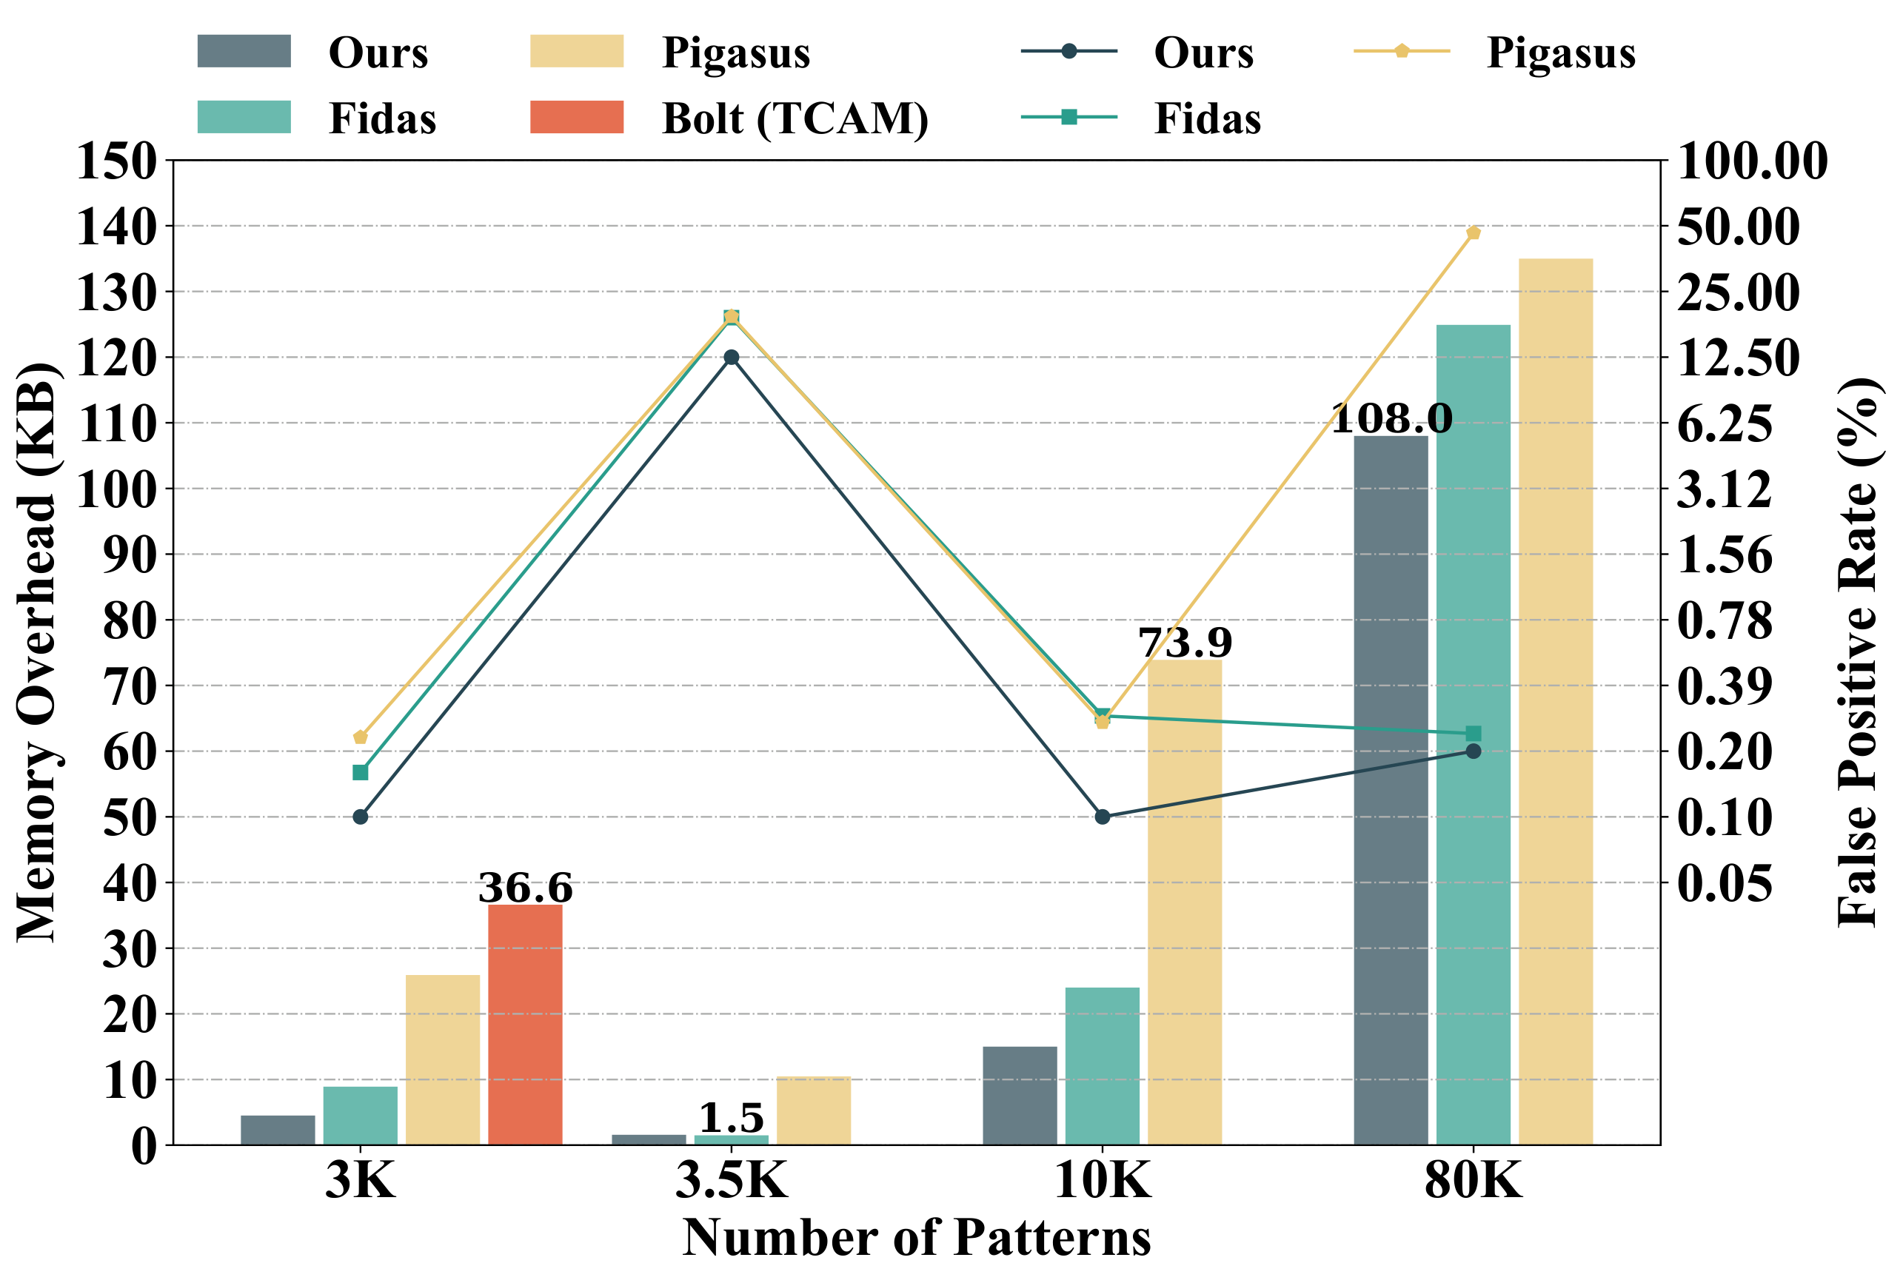
Memory Efficiency Comparison
Memory overhead and false positive rate comparison under different numbers of patterns. Bars represent memory overhead (KB); lines represent false positive rate (%).
Notes:
This figure compares memory overhead and false positive rate against the state-of-the-art, Pigasus. The bars show memory consumption in KB, and the lines show false positive rates.
Our unified memory approach achieves 4 to 5 times less memory consumption compared to Pigasus across different pattern counts. This is the direct benefit of eliminating fragmentation — we use the same total BRAM but fit far more patterns into it. The false positive rate remains comparable, meaning we don't sacrifice filtering accuracy for memory efficiency.

Slide 12
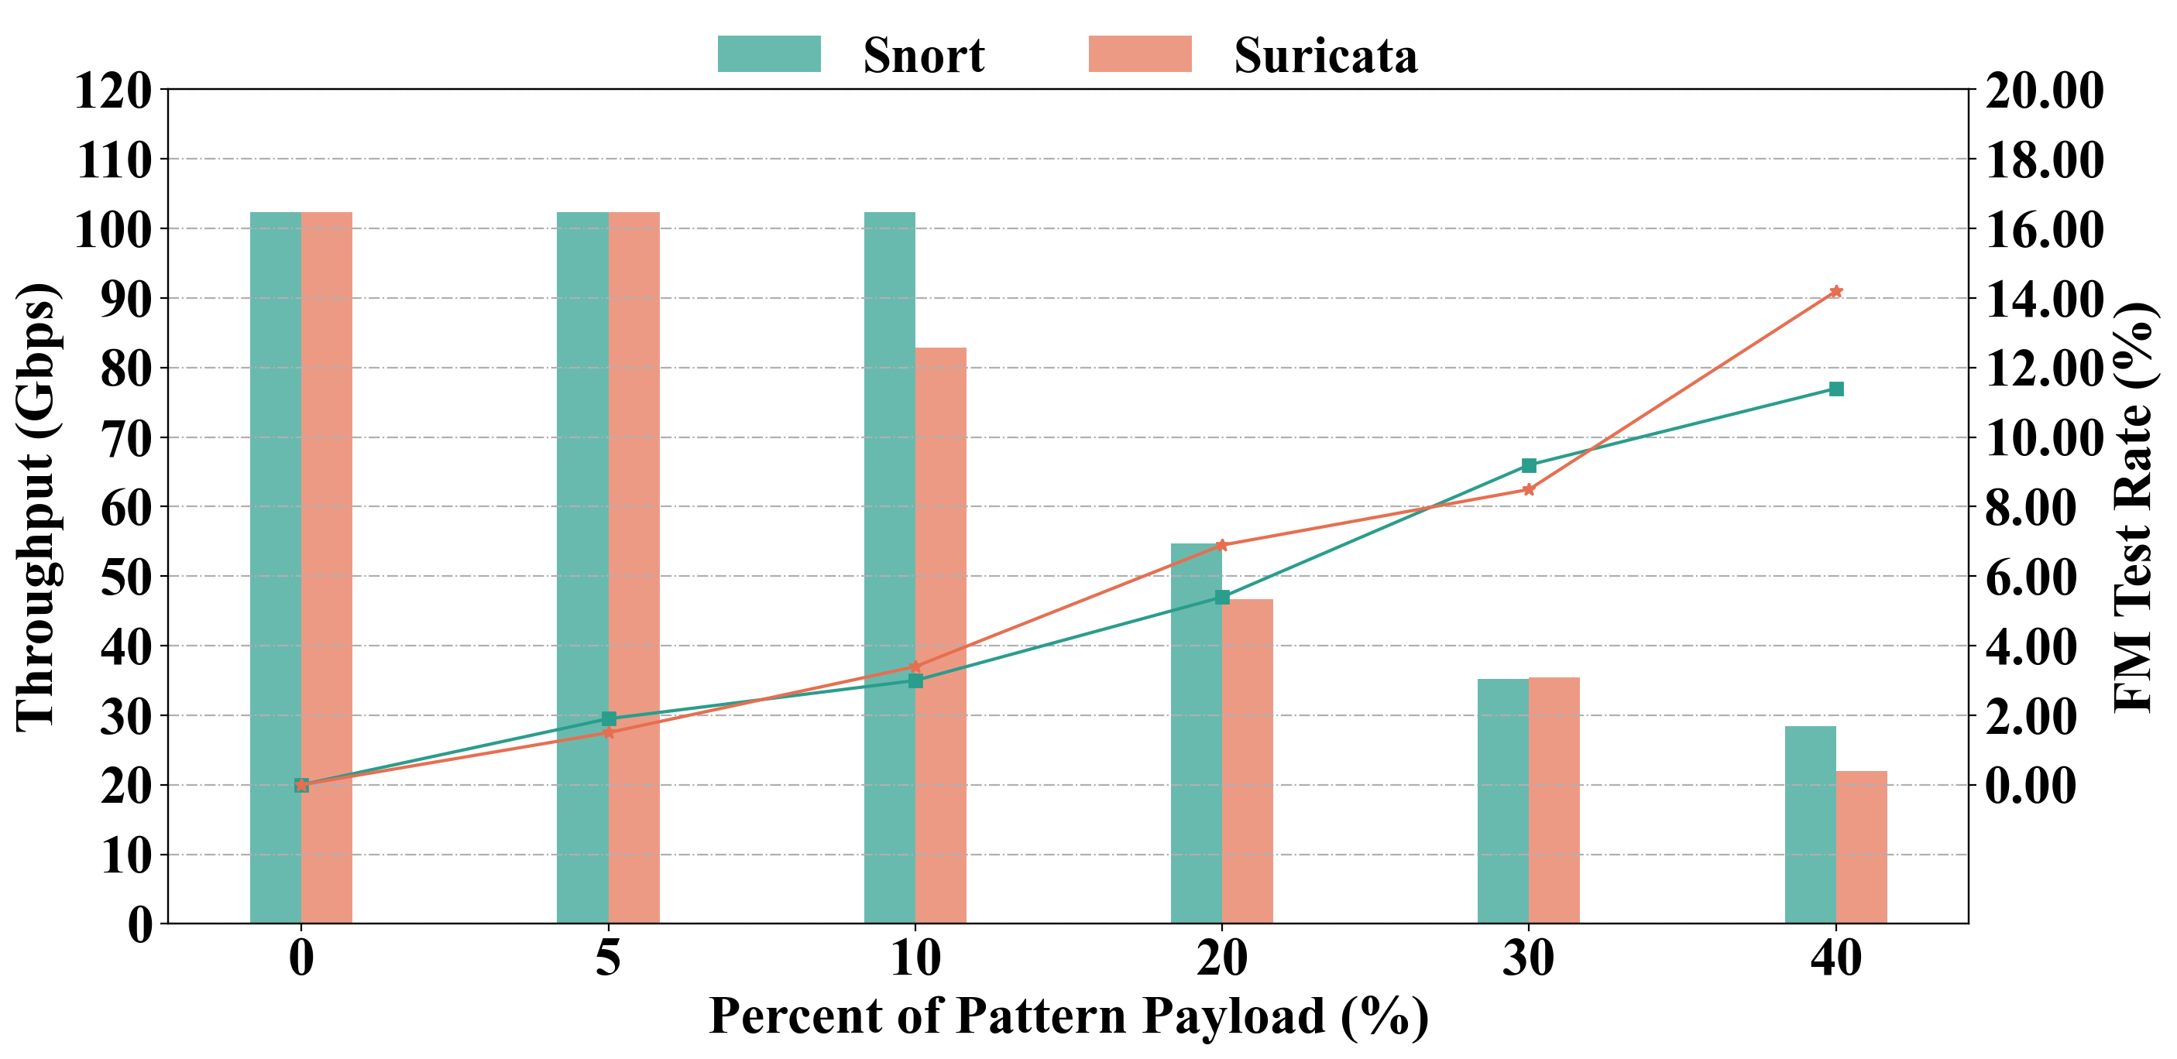
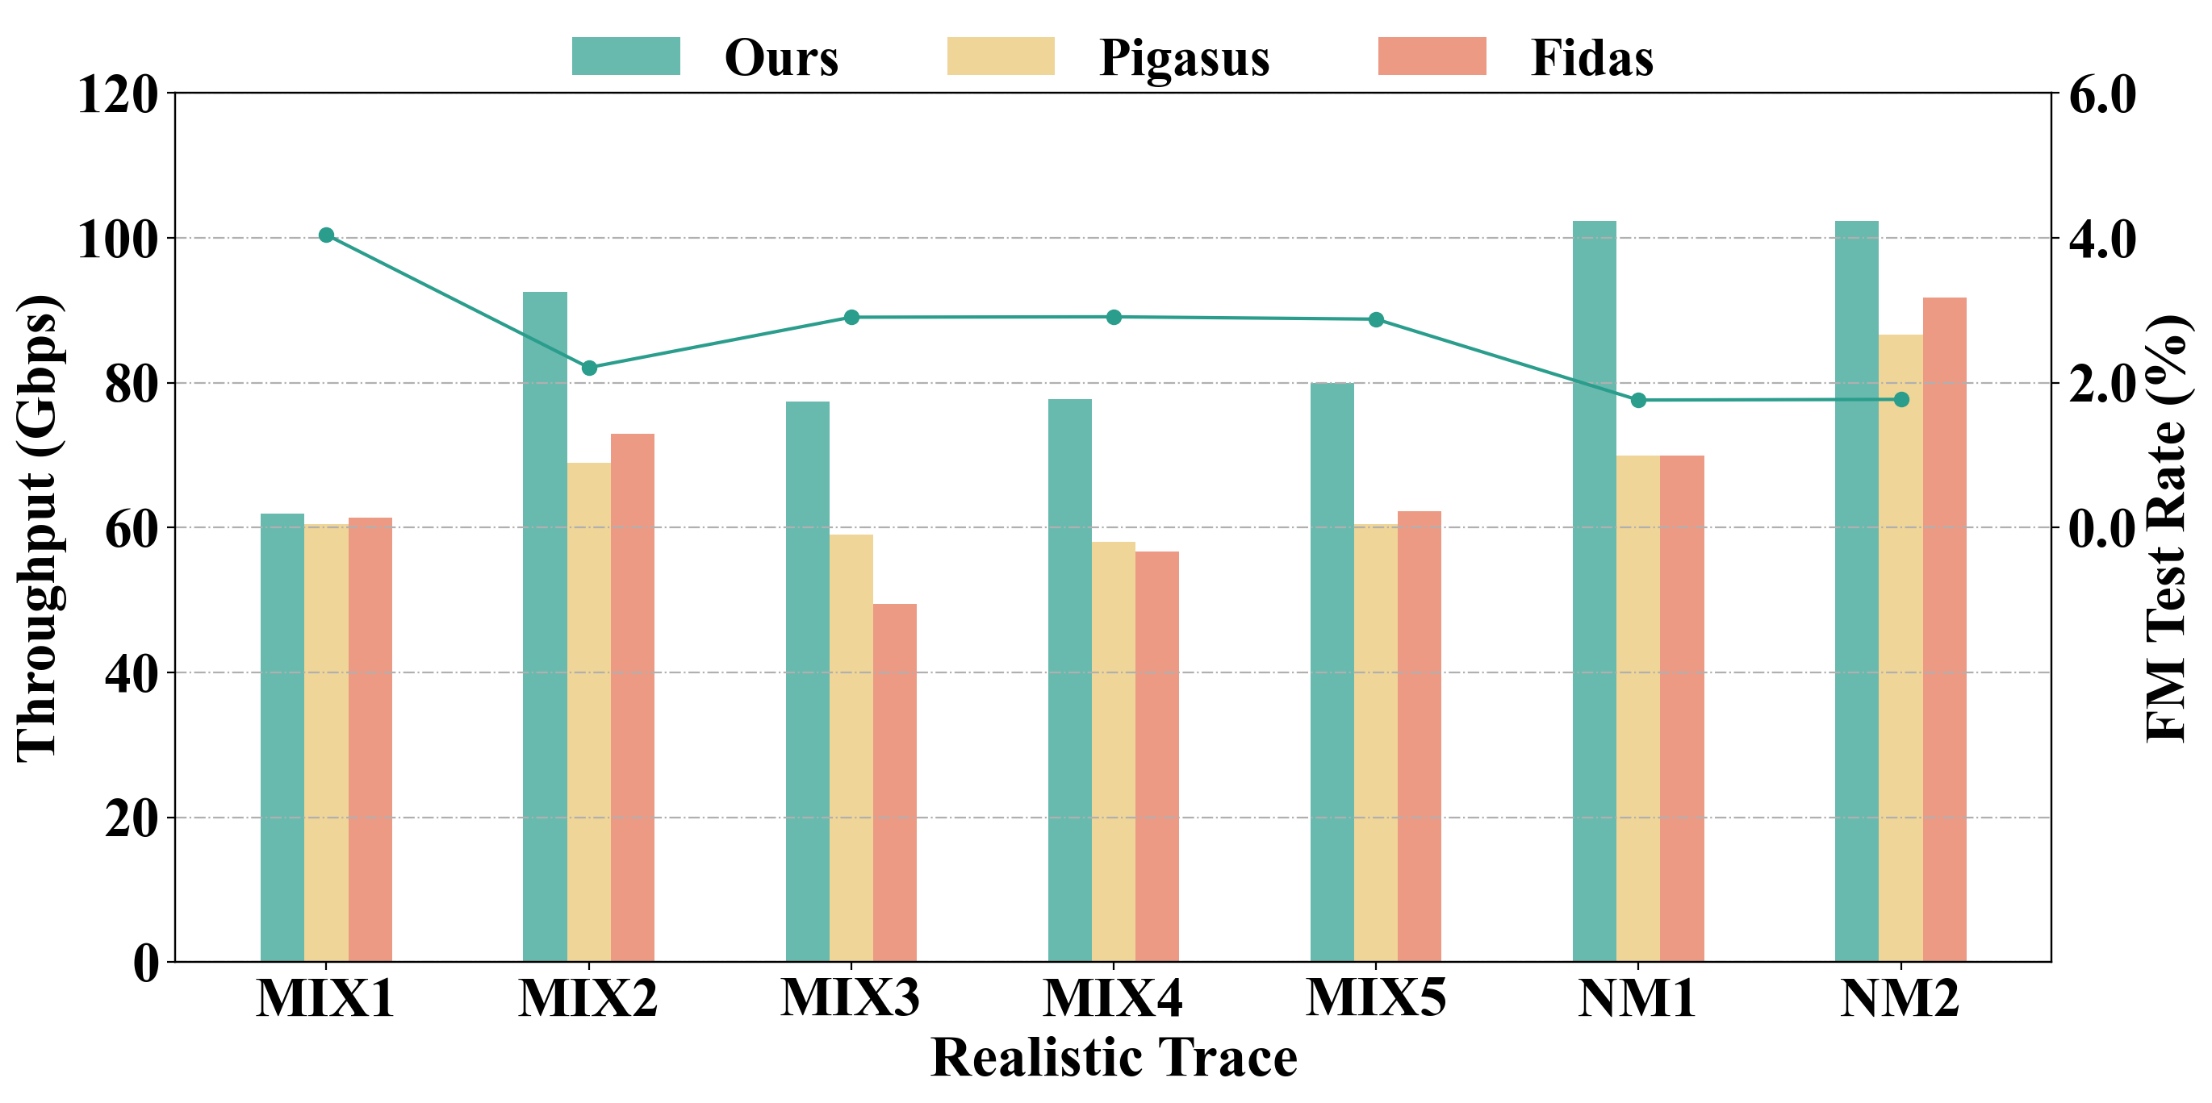
Throughput Evaluation
Network Traffic
100 Gbps
64 × filters (pre-filter)
~99% packets filtered
2 × Verification
eliminates false positives
CPU
further inspection
Throughput measured on full FPGA pipeline. Paper scope: pre-filter module — comparison shown as reference (our design integrates into complete systems without throughput penalty).
Zero-loss throughput under payloads with
different pattern-payload percentage.
Zero-loss throughput under different
realistic trace.
Notes:
A quick note on the system context before the throughput results. Our paper focuses on the pre-filter module, but on the FPGA we also implemented a lightweight verification stage — as shown in the diagram at the top, the 64 parallel matching units of our system feed into 2 verification modules that eliminate false positives before matches reach the CPU. I want to be transparent here: since Pigasus and Fidas are complete IDS systems while ours is a pre-filter prototype, this throughput comparison is meant as a reference — it demonstrates that our module can be integrated into full systems like theirs without introducing a throughput bottleneck.
With that context, on the left we show zero-loss throughput under synthetic payloads with varying pattern-payload percentages. When the pattern-payload ratio is within 10% — which reflects realistic traffic conditions where malicious content is a small fraction — our system sustains 100 Gbps line rate. Beyond 10%, throughput gracefully degrades because more packets are forwarded to the verification module, and the verification test rate rises accordingly.
On the right, zero-loss throughput on seven realistic traces. Compared to Pigasus and Fidas, our system consistently delivers higher throughput across every trace — reaching around 100 Gbps on the normal traffic traces NM1 and NM2, and 60 to 90 Gbps on the malicious mixes MIX1 through MIX5. Even on the heaviest mix, we stay ahead of the two baselines.
These results confirm that the unified memory architecture and crossbar switch introduce no throughput bottleneck, and the design can plug into existing FPGA IDS pipelines with a clear performance edge.

Slide 13
Summary
4-5×
100 Gbps
80K
Less Memory
vs Pigasus
Line-Rate
Throughput
Arbitrary-Length
Patterns Supported
Key Contributions
• Unified memory architecture eliminates fragmentation across pattern lengths
• Cross Hash achieves collision-free access with 90%+ bank utilization
• Crossbar switch enables non-blocking parallel RAM access
• Practical deployment: supports full Snort + Suricata rule sets
Limitations & Future Work
• Currently supports exact string matching; regex support is future work
• Evaluated on FPGA; ASIC implementation could further reduce area
Notes:
To summarize our contributions: First, we achieve 4-5x memory reduction compared to Pigasus by eliminating per-length fragmentation. Second, we maintain 100 Gbps line-rate throughput through parallel pipeline processing. Third, we support 80K patterns with arbitrary length distributions within a specified length range — the full capacity is available regardless of how patterns are distributed across lengths.
Our key contributions are: the unified memory architecture that eliminates fragmentation, Cross Hash combined with the crossbar switch for non-blocking parallel RAM access with over 90% utilization, and practical deployment supporting full Snort and Suricata rule sets.
For future work, we plan to extend support to regular expression matching and explore ASIC implementations for further area reduction.

Slide 14
Thank you. Questions?
Notes:
Thank you for your attention. I'm happy to take questions.
Anticipated Q&A:
- Q: How does this compare to Bloom filter approaches? A: Xor filters are more compact (1.23 bits/key vs 1.44 for Bloom at same FPR) and have fixed 3-access lookup, making them better suited for FPGA.
- Q: What about dynamic rule updates? A: Currently offline; online incremental construction is future work.
- Q: Can the crossbar scale? A: Yes, crossbar complexity grows as O(N log N) with Benes network topology, tested up to 48 ports.
- Q: Why not just use more BRAM? A: BRAM is the scarcest FPGA resource; saving 4-5x frees it for other accelerator functions.

